Slide 1
DETECTING PHISHING WEBSITES USING MACHINE LEARNING
CSE 2018-2022
TEAM MEMBERS:1) PATIBANDA PRANAV NAGA RAJA PRAKASH - 38110419
2) AKULA ABINAY - 38110009
GUIDE: DR.JUDGI

Slide 2
Presentation Outline
Introduction
Problem Definition
Objective
Literature Survey
System Architecture
Workflow Diagram
Dataset
Algorithms Used
Modules
System requirements
Output screenshots
Conclusion
References

Slide 3
Introduction
Phishing is a type of extensive fraud that happens when a malicious website act like a real one keeping in mind that the end goal to obtain touchy data, for example, passwords, account points of interest, or MasterCard numbers.
In spite of the fact that there are a few contrary to phishing programming and methods for distinguishing potential phishing endeavours in messages and identifying phishing substance on sites, phishes think of new and half breed strategies to go around the accessible programming and systems.
Phishing is a trickery system that uses a blend of social designing what's more, innovation to assemble delicate and individual data, for example, passwords and charge card subtle elements by taking on the appearance of a dependable individual or business in an electronic correspondence. Phishing makes utilization of spoof messages that are made to look valid and implied to be originating from honest to goodness sources like money related foundations, ecommerce destinations and so forth, to draw clients to visit fake sites through joins gave in the phishing email. The misleading sites are intended to emulate the look of a genuine organization site page.
The employing so as to phishing invader's trap clients diverse social building strategies, for example, debilitating to suspend client accounts on the off chance that they don't finish the account upgrade process, give other data to approve their records or a few different motivations to get the clients to visit their satirize page.
Supervised learning (Classification Technique) accommodates a vastly improved precision while unsupervised learning accommodates a quick and dependable way to deal with infer information from a dataset. That's why we used supervised learning in our work.

Slide 4
Problem Definition
Detection of Malicious URLs websites hosting phishing, spam etc by using Machine Learning.

Slide 5
Scope and Objectives
The system should be useful in many e-commercial websites for maintaining the security and reliability of customers and people online
The system should be useful in preventing online frauds leading to leakage of important and private user data
The scope of using Machine Language over other Traditional Detecting Methods
Objectives:
Understanding phishing domain (or Fraudulent Domain) characteristics, its distinguishing features from legitimate domains
Why it is so important to detect this domain and how they can be detected using machine learning and natural language processing techniques
Reviewing the state-of-the-art machine learning techniques for malicious URL detection in literature
Understanding the newly emerging concept of Malicious URL Detection as a service and the principles to be used while designing such a system.
To distinguish the phishing websites from the legitimate websites and ensure secure transactions to users

Slide 6
LITERATURE SURVEY
S.NO | TITLE | AUHTOR/YEAR | DESCRIPTION | TECHNIQUE
1 2 3 | Detecting Phishing Websites via Aggregation Analysis of Page Layouts Detection of Phishing Websites using Machine Learning A Novel Machine Learning Approach to Detect Phishing Websites | JianMao ,JingdongBian ,WenqianTian ,ShishiZhu ,TaoWei ,AiliLi ,ZhenkaiLiang 2018 Atharva Deshpande , Omkar Pedamkar , Nachiket Chaudhary , Dr. Swapna Borde/ 2021 Ishant Tyagi; Jatin Shad; Shubham Sharma; Siddharth Gaur; Gagandeep Kaur/ 2018 | In this paper, we aim to improve phishing detection techniques using machine learning techniques. In particular, we propose a learning-based aggregation analysis mechanism to decide page layout similarity, which is used to detect phishing pages. Our experiment results shows that our approach is accurate and effective in detecting phishing pages. This paper surveys the features used for detection and detection techniques using machine learning. Phishing is popular among attackers, since it is easier to trick someone into clicking a malicious link which seems legitimate than trying to break through a computers defense systems. The malicious links within the body of the message are designed to make it appear that they go to the spoofed organization using that organizations logos and other legitimate contents. This paper is focused on various Machine Learning algorithms aimed at predicting whether a website is phishing or legitimate. Machine learning solutions are able to detect zero hour phishing attacks and they are better at handling new types of phishing attacks, so they are preferred. In our implementation, we managed an accuracy of 98.4% in prediction a website to be phishing or legitimate. | Support Vector Machine (SVM), DecisionTree (DT) Random forest algorithm and Decision tree Decision Tree, Random Forest, Gradient Boosting (GBM), Generalized Linear Model and K-Nearest-Neighbors (KNN).

Slide 7
LITERATURE SURVEY
S.NO | TITLE | AUHTOR/YEAR | DESCRIPTION | TECHNIQUE
4 5 6 | Phishing Detection Using Machine Learning Techniques Development of anti-phishing browser based on random forest and rule of extraction framework Detecting Phishing Attacks Using Natural Language Processing and Deep Learning Models | Vahid Shahrivari, Mohammad Mahdi Darabi, Mohammad Izadi/ 2020 Mohith Gowda HR, Adithya MV, Gunesh Prasad S & Vinay S/ 2020 Fenny Zalavadia,Akshata Nevrekar, Priyanka Pachpande,ShubhangiPandey,andDr.Sharvari Govilkar / 2019 | One of the most successful methods for detecting these malicious activities is Machine Learning. This is because most Phishing attacks have some common characteristics which can be identified by machine learning methods. In this paper, we compared the results of multiple machine learning methods for predicting phishing websites. In this paper, we propose a novel technique to identify phishing websites effortlessly on the client side by proposing a novel browser architecture. In this system, we use the rule of extraction framework to extract the properties or features of a website using the URL only. This list consists of 30 different properties of a URL, which will later be used by the Random Forest Classification machine learning model to detect the authenticity of the website. The approach will also use Deep Learning frameworks with hierarchical long-short term memory networks (H-LSTMs) and attention mechanisms to model the emails simultaneously at the word and sentence level. Phishing attacks categorizes the emails based on certain properties which give more details about the source of phishing. Generally, most of the existing systems focus on email classification depending upon header part or body part. | Logistic Regression, Decision Tree, Random Forest, Ada-Boost, Support Vector Machine, KNN, Artificial Neural Networks, Gradient Boosting, and XGBoost. Random Forest Classification machine learning model SVM, Naive Bayes, neural network, LSTM.

Slide 8
LITERATURE SURVEY
S.NO | TITLE | AUHTOR/YEAR | DESCRIPTION | TECHNIQUE
7 8 | Performance comparison of classifiers on reduced phishing website dataset On Feature Selection for the Prediction of Phishing Websites | Murat Karabatak; Twana Mustafa/ 2018 Wesam Fadheel; Mohamed Abusharkh; Ikhlas Abdel-Qader/ 2017 | In this paper, phising website dataset taken from UCI was investigated. Its dimension was reduced and the performance comparison of classification algorithms is studied on reduced phishing website dataset. Phishing website dataset was taken from UCI machine learning repository. This dataset consists of 11055 records and 31 features. Feature selection algorithms were applied to reduce the dimension of phishing website dataset and to obtain higher classification performance. Then, the performance of classification algorithms is compared to other data mining classification algorithms. Finally, a comparative classification performance on the reduced dataset by using the common classification algorithms is given. In this study, we implemented Kaiser-Meyer-Olkin (KMO) Test as a feature selection method and applied that to a publicly available phishing dataset, namely, the UCI of phishing website. furthermore, we used Logistic Regression and Support Vector Machine as classification methods to validate the feature selection method. Our results show just a slight difference in accuracy between implementation using full dataset features and the proposed much smaller dataset (almost 63% of original features set). | Naive Bayes Classifier,J48 decision tree, Random Forest Logistic Regression and Support Vector Machine

Slide 9
System Architecture
URL Phishing Dataset
Preprocessing
Feature Extraction
Prediction Result
Decision Tree Algorithm
Random Forest Algorithm
Performance

Slide 10
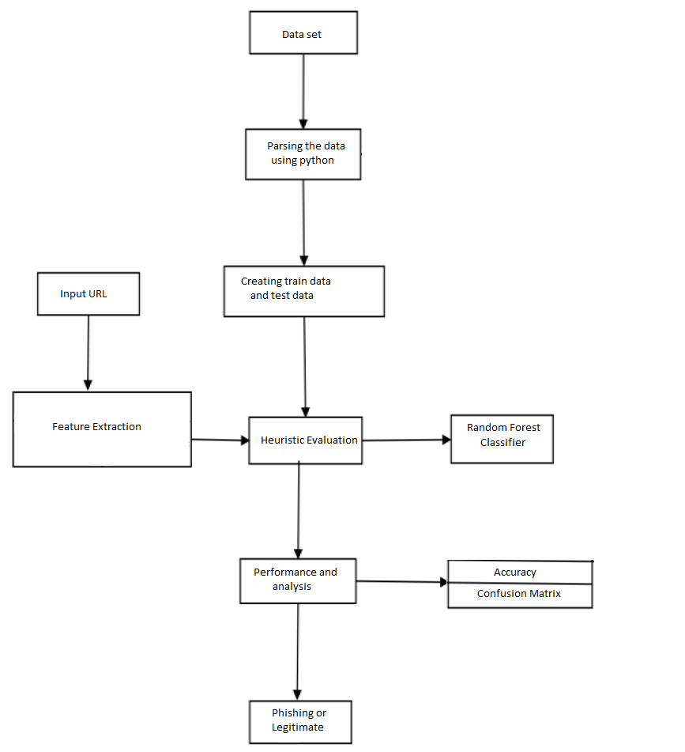
Data Flow Diagram

Slide 11
Data Set
One of the challenges faced by our research was the unavailability of reliable training datasets. In fact, this challenge faces any researcher in the field. However, although plenty of articles about predicting phishing websites using data mining techniques have been disseminated these days, no reliable training dataset has been published publically, maybe because there is no agreement in literature on the definitive features that characterize phishing websites, hence it is difficult to shape a dataset that covers all possible features.
In this article, we shed light on the important features that have proved to be sound and effective in predicting phishing websites. In addition, we proposed some new features, experimentally assign new rules to some well-known features and update some other features.

Slide 12
Algorithms
Decision Tree Classification
Random Forest Classification

Slide 13
Decision Tree
Decision tree is a tree-based algorithm in which Gini index/gain measure is used to identify the root. This procedure
applied recursively to build the whole tree.There is a threshold for splitting the tree.

Slide 14
Random Forest
Random forest is an ensemble learning model. It combines various decision tree to assign a new data point to a class.As it
uses the decision of several decision trees, it is considered as a powerful model.

Slide 15
Modules
Detection Technique
Phishing Websites Features

Slide 16
Detection Technique
Detection of phishing websites has received a lot of attention recently due to their impact on users’ security. Therefore, many techniques have been developed to detect phishing websites varying from communication-oriented techniques, such as authentication protocols, blacklisting, and white-listing, to content-based filtering techniques. The blacklisting and white-listing techniques have not proven though to be sufficiently efficient when used in different domains, and thus they are not commonly used. Meanwhile, the content-based phishing filters have been widely used and have proven to be of high efficiency. In light of this, researches have focused on content-based mechanism and on developing machine learning and data mining techniques based on the header and body of emails.

Slide 17
Phising Website Features
One of the challenges faced by our research was the unavailability of reliable training datasets. In fact, this challenge faces any researcher in the field. However, although plenty of articles about predicting phishing websites using data mining techniques have been disseminated these days, no reliable training dataset has been published publically, maybe because there is no agreement in literature on the definitive features that characterize phishing websites, hence it is difficult to shape a dataset that covers all possible features.
In this article, we shed light on the important features that have proved to be sound and effective in predicting phishing websites. In addition, we proposed some new features, experimentally assign new rules to some well-known features and update some other features.

Slide 18
System Requirements
Hardware Requirements
System : Intel Pentium IV 2.80 GHz.
Monitor : LED.
Mouse : Logitech.
Ram : 4.00 GB or above 4.00 GB
Hard Disk : 250 GB
Software Requirements:
Operating system : Windows 7, Ubuntu
Language : Python 3

Slide 19
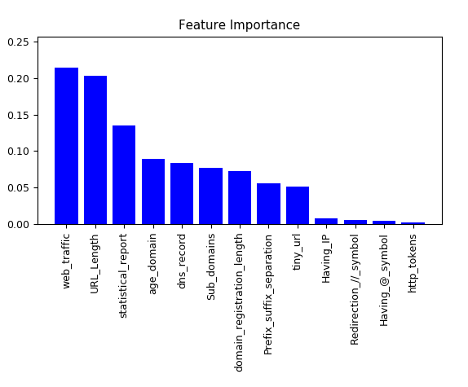

Slide 20
Conclusion
Phishing is a cyber crime procedure utilizing both social building and specialized deception to take individual sensitive data. Besides, Phishing is considered as another extensive type of fraud. Experimentations against recent dependable phishing data sets utilizing different classification algorithm have been performed which received different learning methods. The base of the experiments is accuracy measure.
The aim of this research work is to predict whether a given URL is phishing website or not. It turns out in the given experiment that Random forest based classifiers are the best classifier with great classification accuracy of 75.47% for the given dataset of phishing site. As a future work we might use this model to other Phishing dataset with larger size then now and then testing the performance of those classification algorithm’s in terms of classification accuracy.

Slide 21
References
[1] Samuel Marchal, Jérôme François, Radu State, and Thomas Engel, “PhishStorm: Detecting Phishing With Streaming Analytics,” IEEE Transactions on Network and Service Management, vol. 11 , issue: 4 , pp. 458-471, December 2014
[2] Mohammed Nazim Feroz,Susan Mengel, “Phishing URL Detection Using URL Ranking,” IEEE International Congress on Big Data, July 2015
[3] Mahdieh Zabihimayvan, Derek Doran, “Fuzzy Rough Set Feature Selection to Enhance Phishing Attack Detection,” International Conference on Fuzzy Systems (FUZZ-IEEE), New Orleans, LA, USA, June 2019
[4] Moitrayee Chatterjee,Akbar-Siami Namin, “Detecting Phishing Websites through Deep Reinforcement Learning,” IEEE 43rd Annual Computer Software and Applications Conference (COMPSAC), July 2019
[5] Chun-Ying Huang,Shang-Pin Ma,Wei-Lin Yeh,Chia-Yi Lin,ChienTsung Liu, “Mitigate web phishing using site signatures,” TENCON 2010-2010 IEEE Region 10 Conference, January 2011
[6] Aaron Blum,Brad Wardman,Thamar Solorio,Gary Warner, “Lexical feature based phishing URL detection using online learning,” 3rd ACM workshop on Artificial intelligence and security, Chicago, Illinois, USA, pp. 54-60, August 2010
[7] Mohammed Al-Janabi,Ed de Quincey,Peter Andras, “Using supervised machine learning algorithms to detect suspicious URLs in online social networks,” IEEE/ACM International Conference on Advances in Social Networks Analysis and Mining 2017, Sydney, Australia, pp. 1104-1111, July 2010

Slide 22
[8] Erzhou Zhu,Yuyang Chen,Chengcheng Ye,Xuejun Li,Feng Liu, “OFSNN:An Effective Phishing Websites Detection Model Based on Optimal Feature Selection and Neural Network,” IEEE Access(Volume:7), pp. 73271-73284, June 2019
[9] Ankesh Anand,Kshitij Gorde,Joel Ruben Antony Moniz,Noseong Park,Tanmoy Chakraborty,Bei-Tseng Chu, “Phishing URL Detection with Oversampling based on Text Generative Adversarial Networks,” IEEE International Conference on Big Data (Big Data), December 2018
[10] Justin Ma,Lawrence K. Saul,Stefan Savage,Geoffrey M. Voelker, “Learning to detect malicious URLs,” ACM Transactions on Intelligent Systems and Technology (TIST) archive Volume 2 Issue 3, April 2011

